Slide 1
Factors impacting Mortality Rate
Junwei, Noha, Junchi, Jess, Oliver, Sarayu

Slide 2

Introduction
Aim: build a predictive model of patient’s outcome in ICU based on SAPS scores, which are a physiological score
Used to determine the final predicted outcome for the patient

Slide 3
Q1:
Which variables contribute the most to a person’s death?

Slide 4
SAPS vs SOFA
Simplified Acute Physiology Score
Used to score ICU
17 cumulative variables
Predict mortality
Sequential Organ Failure Assessment
Assesses performance of organs
Based on 6 different criteria

Slide 5
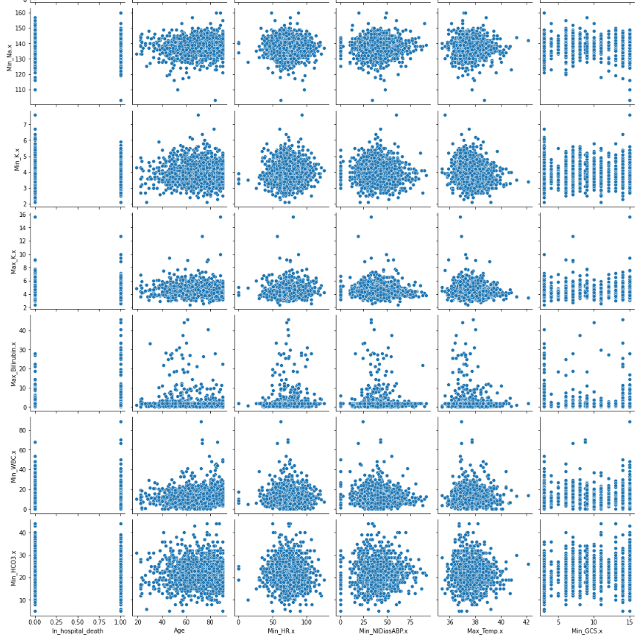
Looked at outcome related descriptors - SAPS and SOFA
SAPS was more relevant and accurate to mortality
Small section of all variable pair plot
Focused on variables relevant to SAPS

Slide 6
Q2:
How does the saps score help us determine which variables carry a greater risk of death?

Slide 7
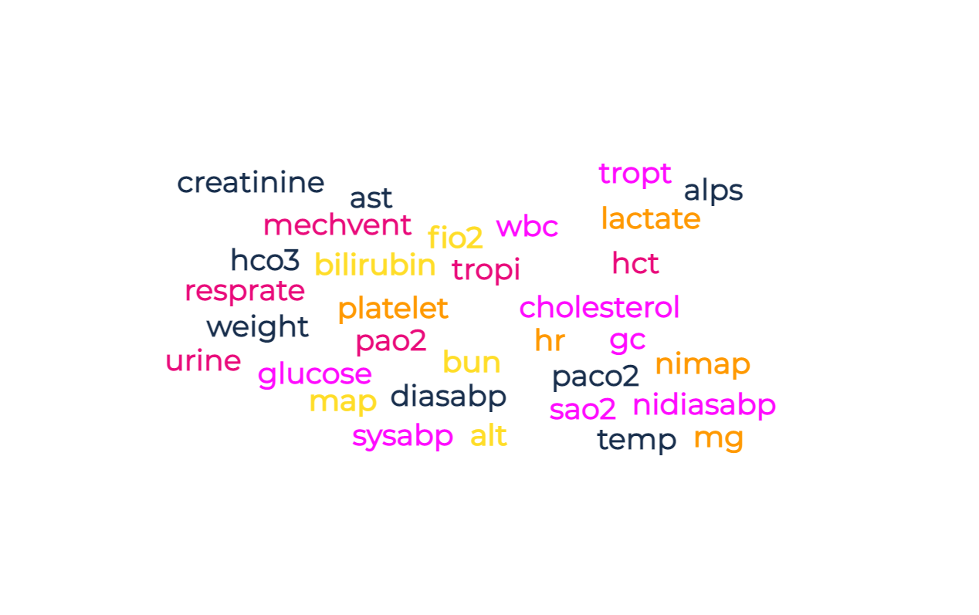

Slide 8
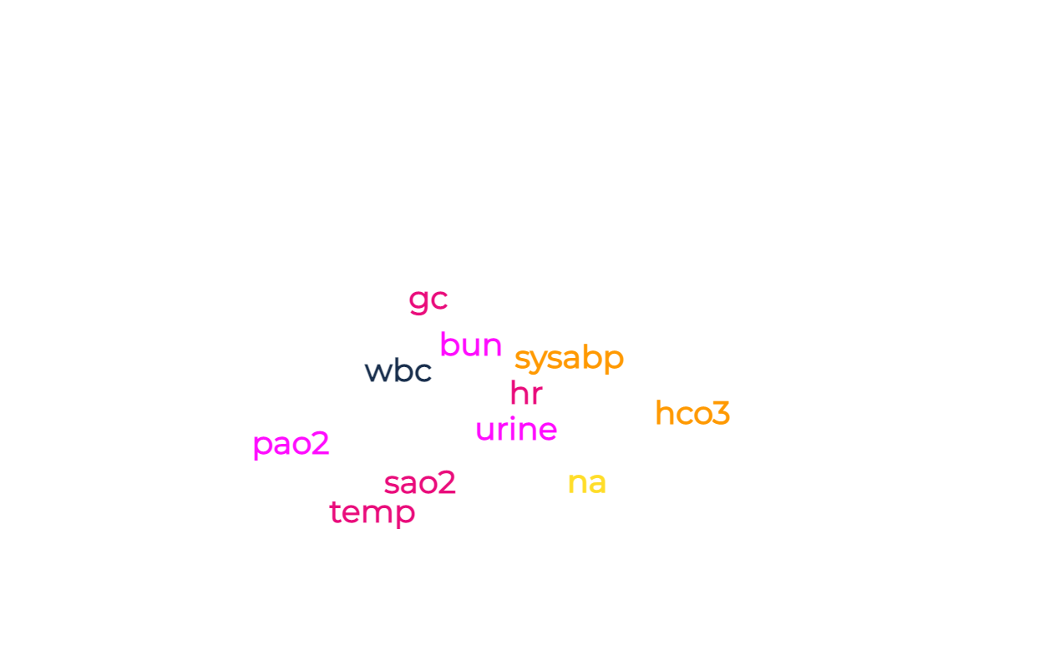

Slide 9
Sodium < 125 mmol/L MORE DANGEROUS!
Sodium > 145 mmol/L
Minimum Sodium ✔

Slide 10
Q3 :
What combination of factors would contribute to the increase in mortality the most?

Slide 11
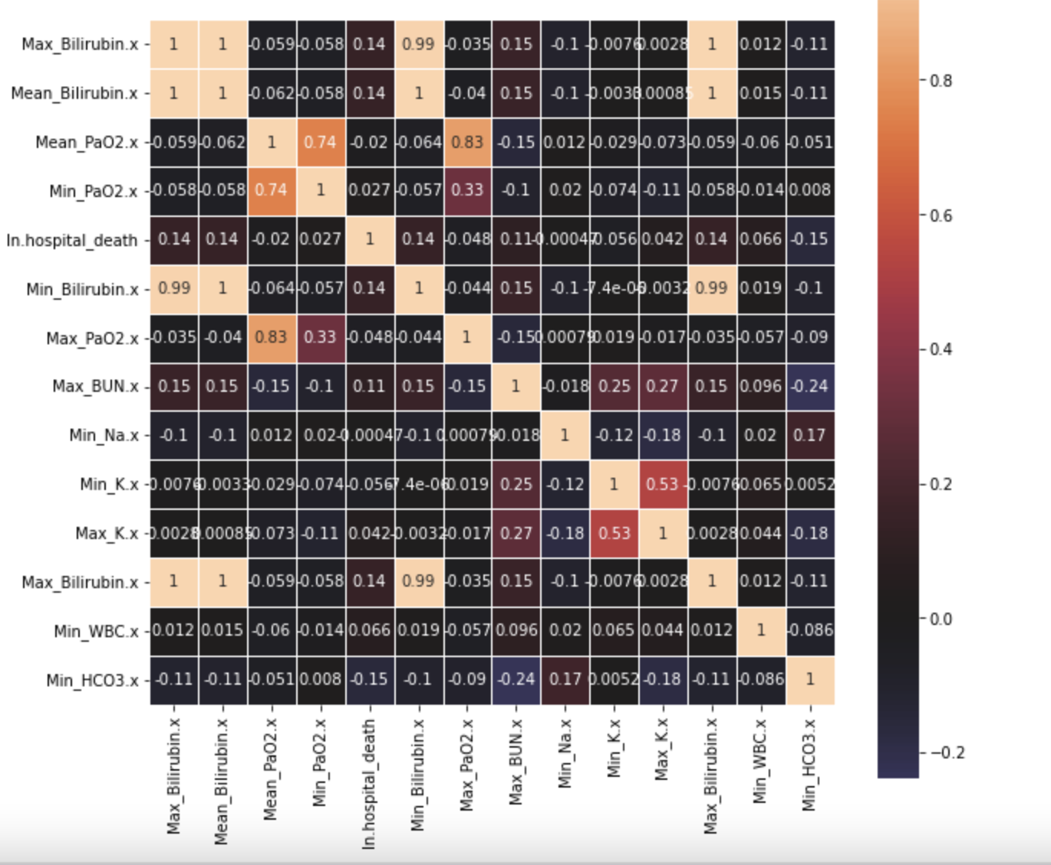
Heatmap of correlation

Slide 12
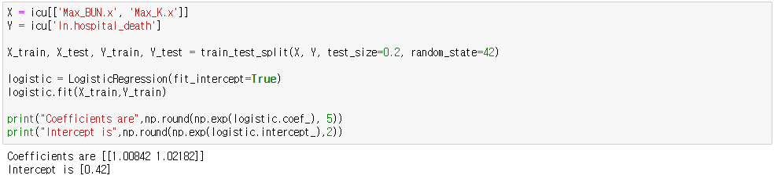
Logistic regression

Slide 13
Q4:
How do the unknown variables (ie. daily urine output, chronic disease, type of admission) contribute to the final predictive outcome?

Slide 14
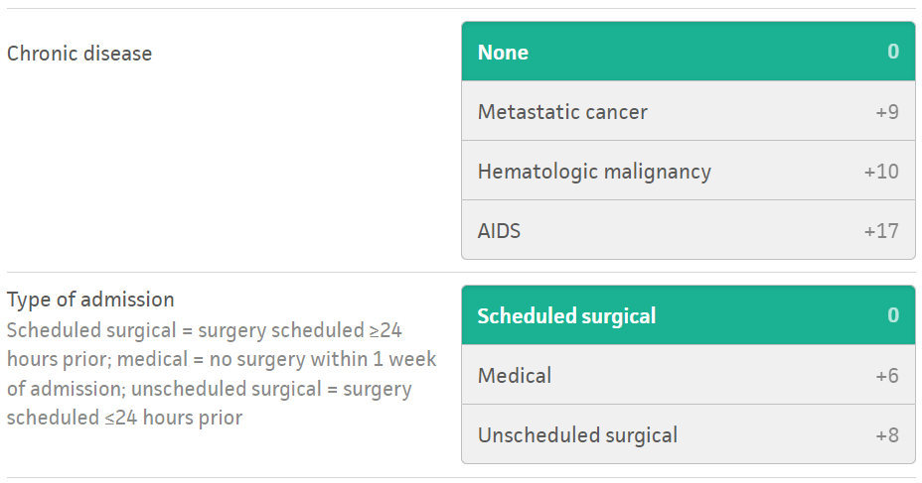

Slide 15
Q5:
Is it possible to make a predictive model based on the variables to determine if a hypothetical patient would survive in the ICU?

Slide 16
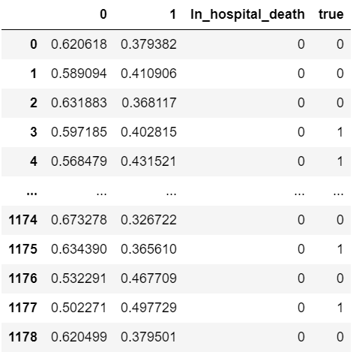
Predictive Modeling
Max BUN + Max Potassium =
0.613 train, 0.6441 test
Max BUN + Min Potassium =
0.6166 train, 0.6440 test
Max BUN + Min Bicarbonate =
0.6378 train, 0.6407 test
Example: Max BUN + Max K

Slide 17
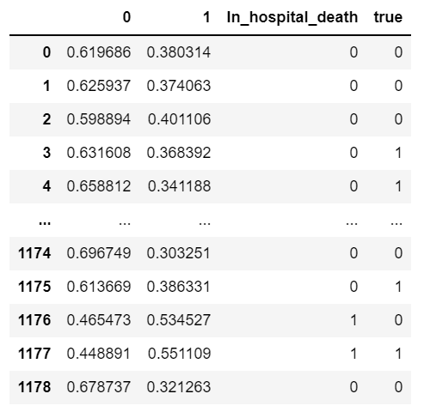
All 4 Variables (Max BUN, Max and Min Potassium, Min Bicarbonate)
0.6395 train, 0.6542 test
This predictive model, whilst only around 15% better than a coin toss, is only made up of 4 variables. So in hindsight, makes for a decent predictive model.

Slide 18
Conclusion
Correlated Variables:
  Maximum Blood Urea Nitrogen (BUN)
  Minimum Potassium (K)
  Maximum Potassium (K)
  Minimum Bicarbonate (HCO3)
Final Model: 15% better than a coin toss
Not fully valid due to missing variables
Further analysis would allow SAPS as only one indicator of morality

